Slide 1




G.H. RAISONI COLLEGE OF ENGINEERING
AND MANAGEMENT, WAGHOLI, PUNE.
Department of AI & AIML
< CurraCon. >
Guide:
< Prof. Nutan Raut >
Name of Projectees
<Lakshya Makode> <Tejas Mundhe>
<Shrivardhan Malge> <Sidharth Newade>

Slide 2
Contents
Introduction
Justifications for Selecting the Title
Problem Statement
Literature Survey
Block Diagram
Expected Result
Work plan
References

Slide 3

Introduction
Introduction / background about the project:
In today's interconnected world, the need for quick and accurate currency conversion has become an integral part of our daily lives. Whether you're a traveler exploring new destinations, a global business professional managing finances, or a curious learner interested in international markets, understanding and converting currencies is essential.
With this in mind, we proudly present "CurraCon." – a cutting-edge mobile application designed to simplify and streamline currency conversion for users of all backgrounds.

Slide 4

Introduction
Introduction / background about the project:
CurraCon. is the result of our dedication and innovation as a college project. We recognized the growing demand for a user-friendly, reliable, and efficient currency conversion tool that caters to the unique needs of individuals and businesses alike.
Our application is designed to bridge the gap between diverse currencies and facilitate seamless transactions and financial decisions in an ever-expanding global economy.

Slide 5

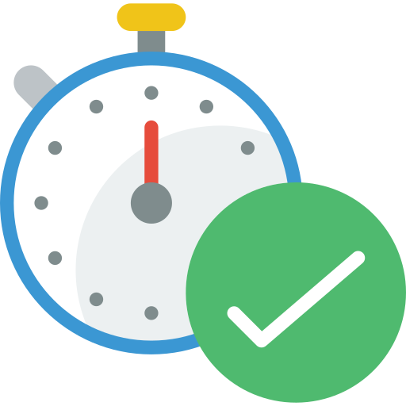

Introduction
Key Features of “CurraCon.” :
Real-Time Exchange Rates: “CurraCon.” provides up-to-the-minute exchange rates, ensuring that users always have access to the most accurate and current conversion rates. Say goodbye to outdated information.
2.Intuitive User Interface: Our user-friendly interface is designed with simplicity in mind, making currency conversion a breeze for users of all tech-savviness levels.

Slide 6
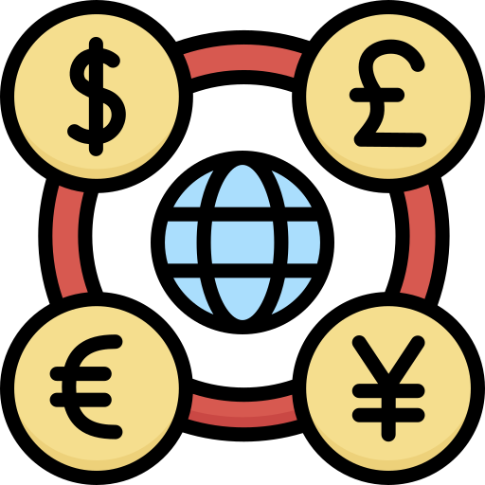
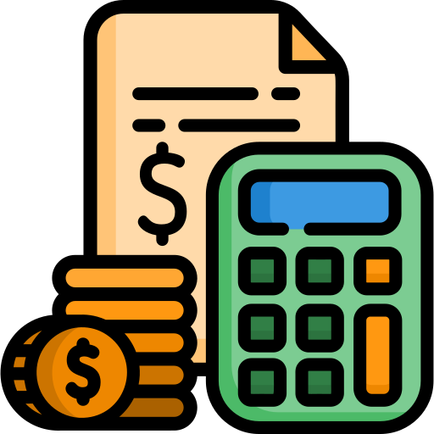
Introduction
3.Multi-Currency Conversion: “CurraCon.” supports a vast array of currencies, allowing users to convert multiple currencies effortlessly. No matter where you are or what currency you need, “CurraCon.” has you covered.
4.Currency Conversion Calculator: Perform precise calculations with our built-in calculator, allowing for easy and accurate conversions on the go.

Slide 7
Justification For Selecting The Title
Justification of title with project:
Whether you're a traveler exploring new destinations, a global business professional managing finances, or a curious learner interested in international markets, understanding and converting currencies is essential.
Since the application we have introduced is based on currency conversion and it includes variety of currencies around the globe, with real-time exchange rates, it was a priority for the team to give the project a title that is relevant to it’s task.
Hence, the name “CurraCon.”
The ‘Curra’ stands for ‘currency’ and the ‘Con’ stands for ‘conversion/converter’.
The ‘.’ in the final is used for styling out the whole title since most of its users will be young audience and enthusiastic travellers.

Slide 8
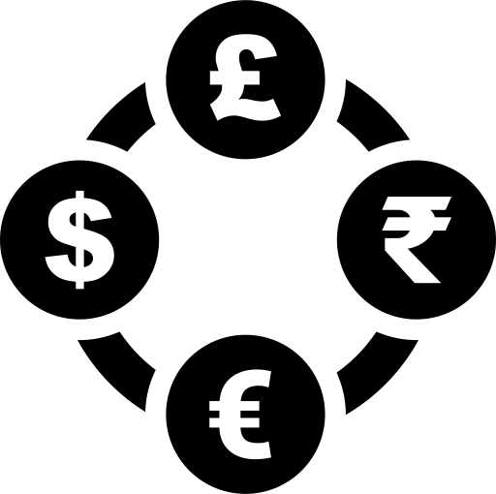

Problem Statement
Problem identified and its justification :
Problem identified :
1.Exchange Rate Accuracy: Currency conversion is challenging due to constantly shifting exchange rates caused by economic and geopolitical factors, potentially causing financial losses.
2.Real-Time Updates: To enable informed financial decisions, currency conversion systems must provide users with real-time exchange rate data, as rates change rapidly.

Slide 9


Problem Statement
Problem identified and its justification :
3.User-Friendly Interface: Ensuring a user-friendly interface and transparently displaying transaction fees is crucial for simplifying currency conversion across various platforms and improving the user experience.
4. Following Rules and Protecting Data: Currency conversion systems need to obey global financial rules, keep user data safe, and handle different languages and currencies. This requires strong solutions to make sure users trust the system.

Slide 10
Literature Survey
Sr. No. | Paper Title and its Author | Details of Publication | Findings
1
2
3
4
5
6

Slide 11
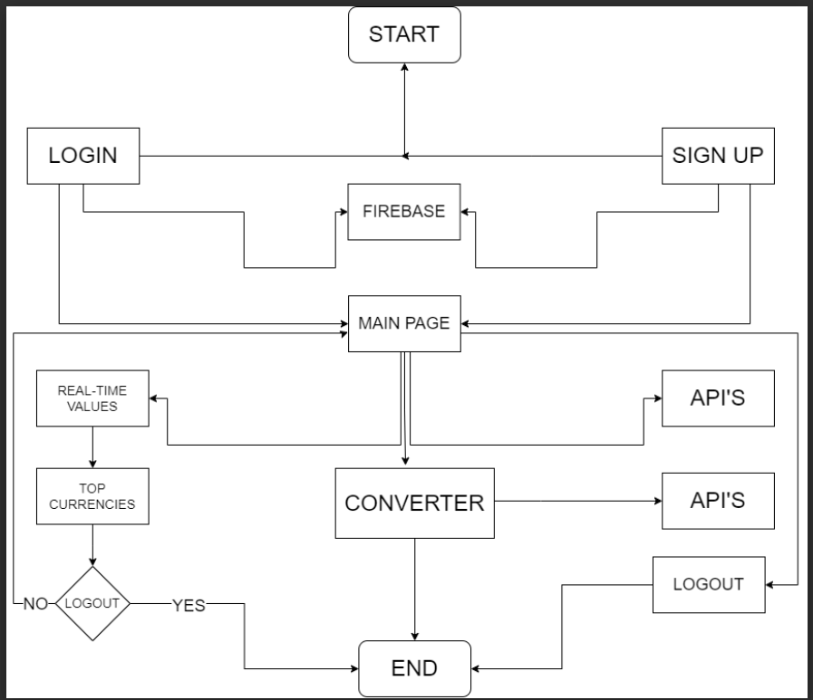
Block Diagram
Block diagram of various stages of project :

Slide 12
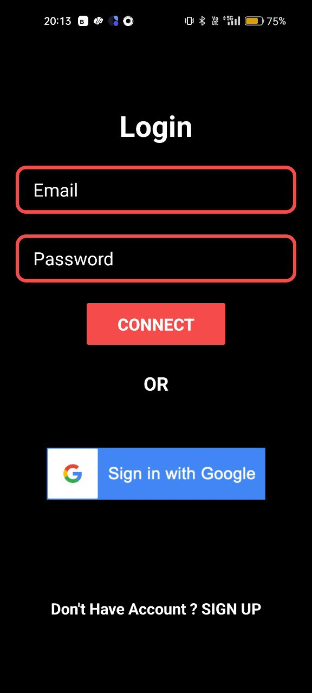
Expected Result
Expected output of the project :
Let’s start with the beginning.
On opening the CurraCon. mobile application, the user will land on a simple login page. So as to enter the app and to authenticate the identity of the end user, he/she need to enter the details required.
Login page :
1. Login Page Purpose: The login page is where users enter their credentials to access the app securely.
2. Control for Authorized Users: It ensures that only approved individuals can use the app, protecting user data and features.

Slide 13
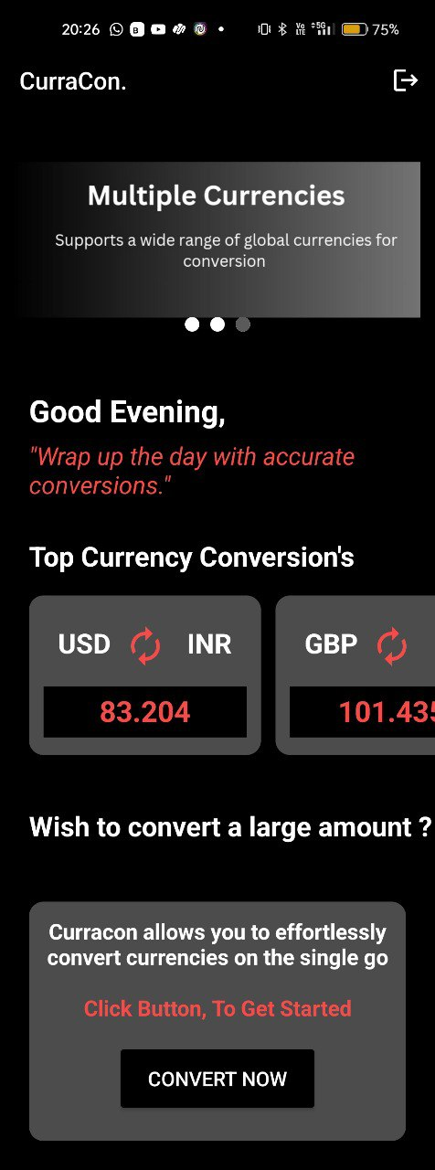
Expected Result
Once you have entered the CurraCon. mobile application, you will see some quotes, a carousel that will be keeping you informed about the CurraCon. application’s interface features.
Nextly, you can also see some real-time converted values from one currency into another.
This will help the user to check the most commonly used currencies and their values into another famous currencies
Also, in the bottom most you can see an option named as ‘CONVERT NOW’, which will give you an opportunity to convert any value from various different currencies of the world into one another.

Slide 14
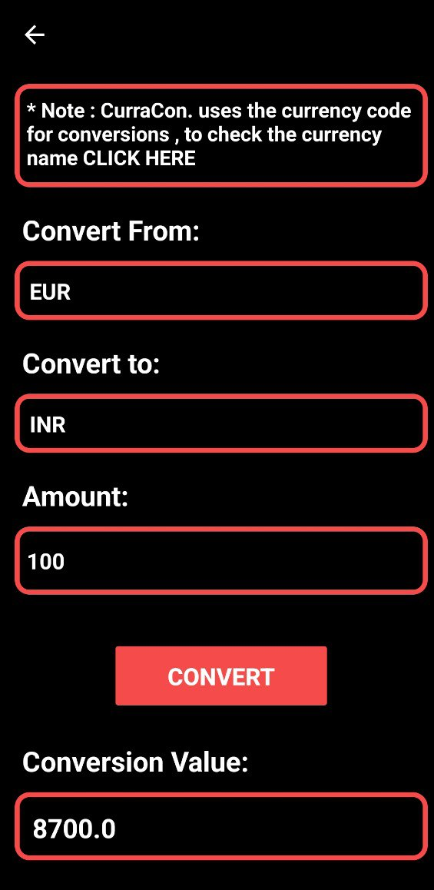
Expected Result
Once you tap on the ‘CONVERT NOW’ option on the MAIN PAGE, you will end up landing onto next page where you can change any desired value from one currency into another.
It will include the following simple steps –
STEP 1 - Tap on the box below the ‘Convert From’ line and simply select the currency from which you want to change the value.
Here, it’s EUR(Europe’s currency)
STEP 2 - Similarly, tap on the box below ‘Convert to’ line and select the currency into the which you desire the value you entered to be changed.
Here, it’s INR(India’s currency)
STEP 3 - Enter the value you want to change.
Here, it’s 100.
STEP 4 - Tap on the ‘CONVERT’ option.
STEP 5 -Voila ! You have acquired with your desired converted value.
As we can see, 100 EURO have an approximate value of 8700 RUPEES.

Slide 15
Expected Result
BACK BUTTON TO LAND ON MAIN PAGE
LOGOUT
BUTTON

Slide 16
Expected Result
Currency conversion is a must task for travellers who travel international trips very frequently.
It helps them while shopping in different countries and easily convert the price of any product into their desired currency.
While booking hotel rooms at the location they travel, user can easily convert given price into his/her required amount.
Getting known about the real time value of currencies which are in high demand becomes more simple with CurraCon..
Converting any given value of any currency through one step process.

Slide 17
Work – Plan
Months Activities | August’23 | Sept’23 | Oct’23 | Nov’23
Literature Reviews | √
Requirement Analysis | √
Designing | √
Experimental Analysis | √ | √ | √
Module wise Implementation |  | √ | √
Testing and Debugging |  |  | √ | √
Preparation of Project Report |  |  |  | √

Slide 18

References
List of papers/books/websites, etc refer for project :
WEBSITE -
https://app.exchangerate-api.com/dashboard
API –
https://v6.exchangerate-api.com/v6/59ceb98f3e2951c4c3976117/latest/USD

Slide 19
Thank
you !

